Slide 1
Mojaloop
Dispute Management Workshop
Dispute Management Workstream
Promesse D. Ishimwe

Slide 2
Agenda
Challenges & Pain Points
Mojaloop Dispute Management MVP
Next: Dispute Management in Payment Return requests
Next: Dispute Management Integration with Fraud Monitoring tools
Next: Dispute Management in Cross Border

Slide 3
ML Dispute MGT
CHALLENGES

Slide 4
Challenges
1. Opaque, Manual Workflows
Reliance on spreadsheets, emails or paper processes leads to slow turnaround, human errors and no clear audit trail.
2. Data Silos & Poor Interoperability
Dispute data trapped in disconnected systems (core banking, fraud engines, networks) hinders end-to-end visibility and reconciliation.
3. Cross-Border & FX Complexities
Time-zone mismatches, foreign-exchange adjustments and varying local rules create extra friction and latency.
4. Integration with Fraud Management
Weak or non-existent hooks between dispute and fraud systems prevent a unified risk view and duplicate investigations.

Slide 5
Challenges
5. Customer Transparency & Communication
Opaque processes and delayed updates erode trust, driving up call-center volumes and complaint rates.
6. SLA Tracking & Performance Metrics
Lack of granular, event-level monitoring makes it hard to enforce service agreements or pinpoint workflow bottlenecks.
7. High Operational Costs
Manual case handling and legacy infrastructures inflate cost-per-case and cap scalability as dispute volumes grow.

Slide 6
ML Dispute MGT
MVP

Slide 7
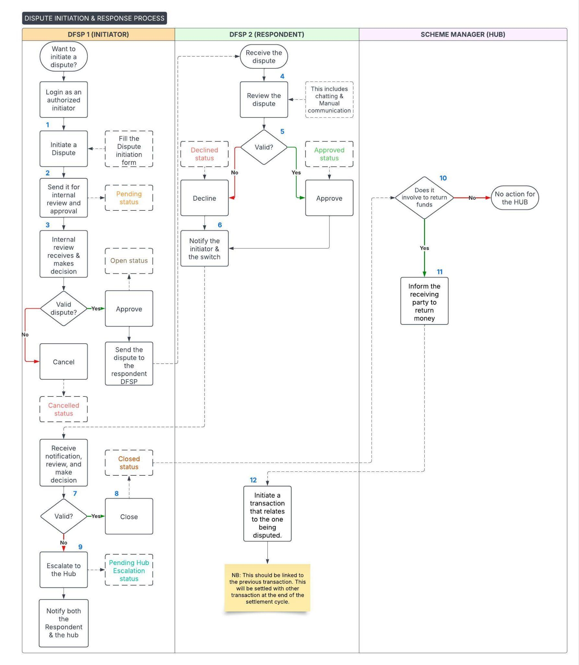

Slide 8
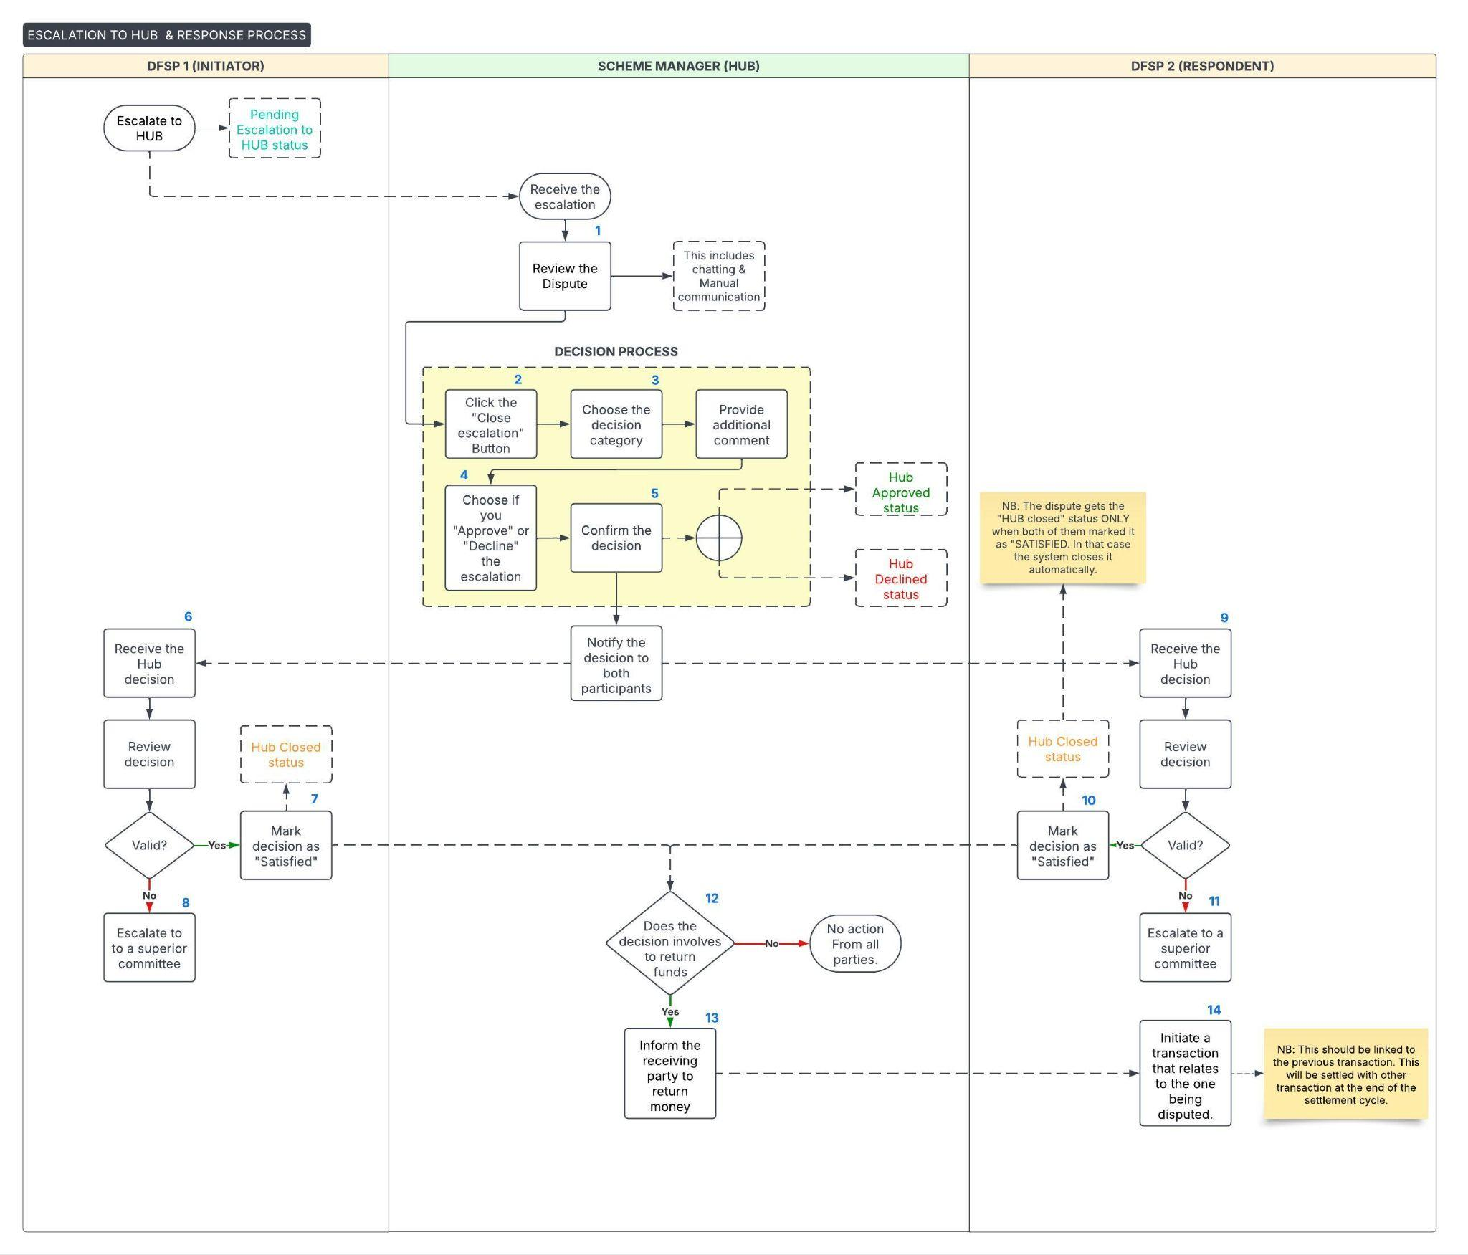

Slide 9
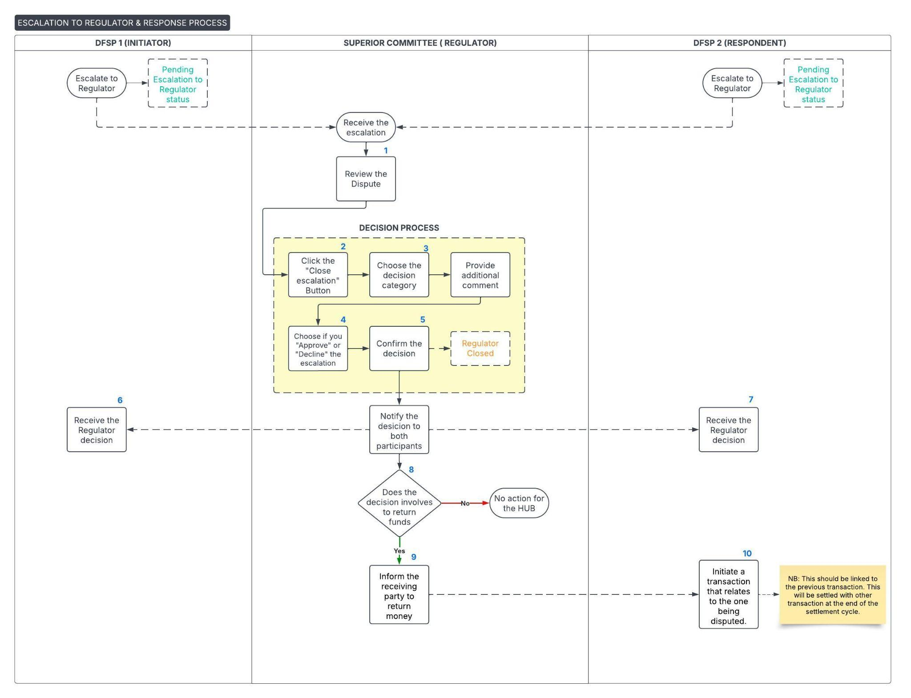

Slide 10
ML Dispute MGT
NEXT USE CASES

Slide 11
1.Streamlining payment returns
Overview
Automatically generate a dispute case when a payment return is triggered by:
Rejected by Recipient (e.g., insufficient funds, account closed)
No Response within configurable SLA window (e.g., 48 hrs)
Key Workflow Steps
Event Listener on “PaymentReturn” or “NoAck”
Auto-Create Dispute record with metadata (orig. payment ID, return reason, timestamps)
Notify Operations via dashboard alert or webhook

Slide 12
Streamlining payment returns
Benefits
Zero manual triage for common return scenarios
Faster time-to-investigation (TTR) and SLAs met automatically
Full audit trail from payment to dispute
Considerations
Configurable thresholds (hours until auto-create)
Mapping of return codes to dispute categories
Notification channels (email, Slack, Ops dashboard)

Slide 13
2. Fraud-triggered Dispute Initiation
Overview
Leverage fraud engines to flag suspicious transactions and kick off disputes automatically
Key Workflow Steps
Fraud Alert generated by monitoring tool (e.g., “High-Risk TXN”)
Webhook/Connector pushes alert to Dispute Mgmt API
Dispute Case created with fraud score, rules triggered, and team assigned

Slide 14
Fraud-triggered Dispute Initiation
Benefits
Proactive dispute handling before customer or network chargebacks
Unified risk view: link fraud events and dispute cases
Reduction in losses by early intervention
Considerations
Standardize fraud-dispute payload schema (ISO 20022 or JSON)
Secure authentication for fraud tool callbacks
Tuning fraud-score thresholds to balance noise vs. coverage

Slide 15
3. Cross-border Dispute Enhancements
Overview
Extend dispute management to support multi-jurisdictional payments
Key Workflow Steps
Capture FX Details (orig. & settlement currencies, rates, date)
Route via Correspondent Bank metadata (intermediate BIC, fees)
Time-Zone Aware SLAs (local cut-off windows per region)

Slide 16
Cross-border Dispute Enhancements
Benefits
Accurate FX reconciling in dispute settlements
Visibility across multiple banking partners
SLA enforcement aligned to local banking hours
Considerations
Maintain currency conversion logs for audit
Configurable bank-specific settlement rules
Holiday calendars and DST adjustments per region

Slide 17
THANK YOU !!!
Let’s build this together!!

